Slide 1
Image to Texture
MJ Kim
Seongho Cho

Slide 2
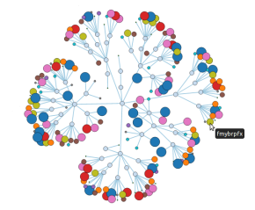

Big Data + Haptics = ??

Slide 3
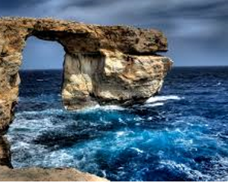
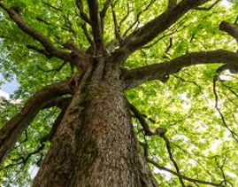
How could you feel the texture of this?

Slide 4
User Interview
Interviewed 10 people
Classificaion of interviewee
1. Have you imagine the texture of the object by looking the picture? (On online-shopping, picture of the nature, or some other situation) 2. What do you usually do for feel the texture? 3. After touching the object, could you remember the feeling after a day? 4. If there’s an object that it seems uncomfortable to touch or unreachable to touch, what do you do than? 5. What If you can feel the texture just by picture, what would be the problem of that technology and what would be need for that technology?
Job : 10 Students Age : 20s Gender : 4 women and 6 men

Slide 5
User Analysis : a relevant point of view
Subjects | Contents
Problem : user’s view | Most of interviewees were not sure about the technology that could make a feeling of realistic surface texture. Some of them worried that it could be used as improper way.
Improvement plan | Focus more onto image recognition and according to that result, we will select the representative texture. For prototype, we will use the nature substances.

Slide 6
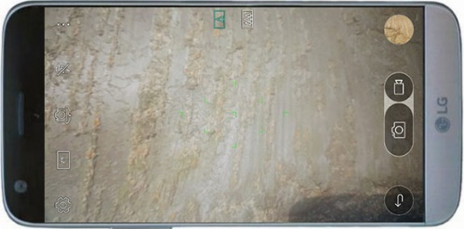


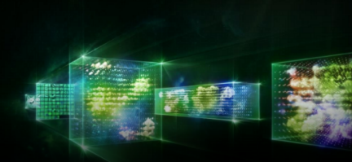

How thing are going to work
Take a picture
User
Surface Feature Recognition
Texture Rendering
Haptic Effect

Slide 7
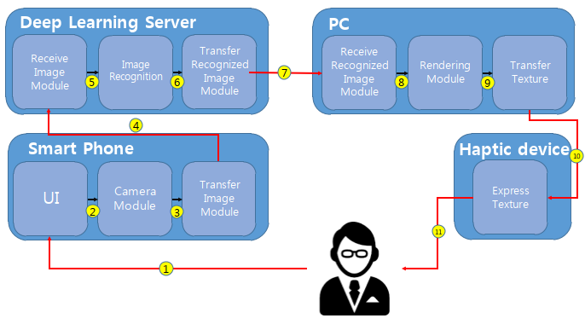
Structure Design

Slide 8
Perspective of HCI principles
Attributes | HCI principles | Impacts
By hand | Usability, Usefulness | (+) Easy to use (+) Don’t have to learn (+) Intuitive to use (-) Reachable distance (-) Could get virus
By image to texture | Usefulness, Affective | (+) Could feel the unreachable object (+) Affect of technology (-) Must have the haptic device (-) Have to feel the texture by unexperienced way

Slide 9
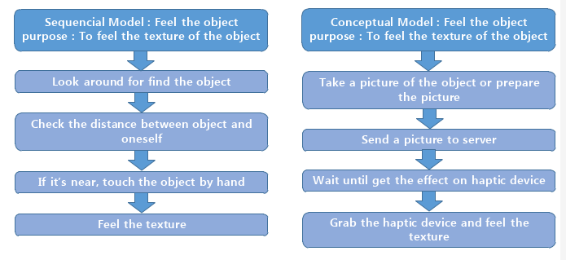
Task Analysis

Slide 10
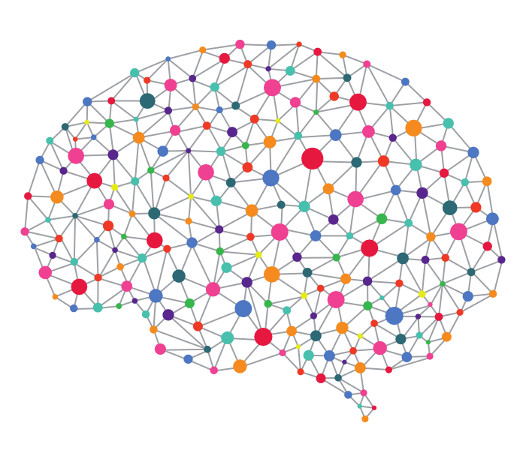
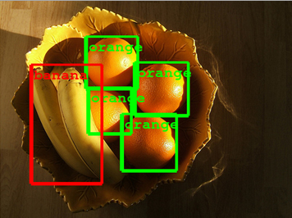
Technology Analysis : Image Recognition
Image Recognition
Deep Learning : Deep Learning is kind of Clustering Technique.
Trainning : For the Image Recognition, Deep Learning server should
study about target objects
At least Take an 800 Pictures each Objects for recognition.

Slide 11
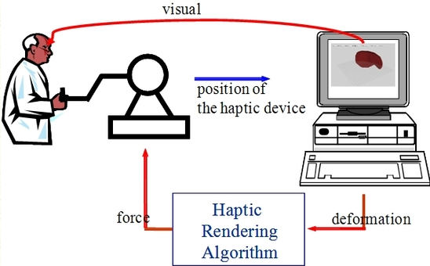
Technology Analysis : Haptics

Slide 12


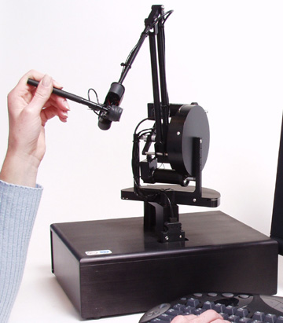
Development environment

Slide 13
Expected Effect
Usefulness : Could feel the surface texture of unreachable object
Instead of express the each image’s surface texture, we will focus more onto image recognition and do rendering the representative texture
If the haptic devices(PHANToM, ...) get lower their prices, then people will pay attention to haptic technology and its field would get more development.

Slide 14
References
[1] Deep learning, http://navercast.naver.com/contents.nhn?rid=122&contents_id=64183
[2] Seungmoon Choi and Hong Z. Tan, “Towards Realistic Haptic Rendering of Surface Textures,” Accepted for publication in IEEE Computer Graphics & Applications (Special Issue – Haptic Rendering Beyond Visual Computing), 2003.
[3] Images from google, https://www.google.co.kr/?gfe_rd=cr&ei=eOEIWP3mJJD-8wemmZLoCA&gws_rd=ssl

Slide 15
Thank you

